Slide 1

Unit-2 Sequence and Series
Mathematics-I
GTU#(3110014)
Prof. Dhvanik H. Zala
Humanities & Science
dhvanik.zala@darshan.ac.in
8238588865

Slide 2

Method:14
Leibnitz’s Test

Slide 3
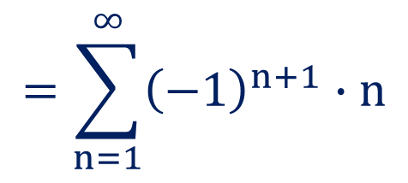

Method:14 Leibnitz’s Test
Alternating Series
A series with alternate positive and negative terms is known as an
alternating series.
$$=\sum_{n=1}^{∞}{{\left(−1\right)}^{n+1}}∙n$$
Ex:
$$1−2+3−4+…$$

Slide 4



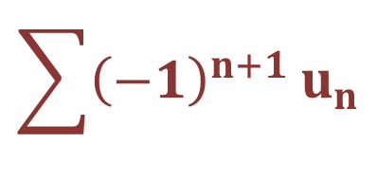
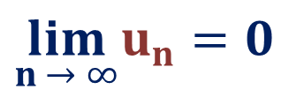



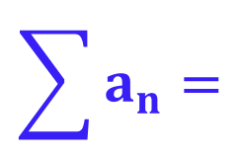
Method:14 Leibnitz’s Test
Leibnitz’s Test
$$\sum{a_{n}}=$$
$$\sum{{\left(−1\right)}^{n+1}}u_{n}$$
An alternating series
$$=u_{1}−u_{2}+u_{3}−…$$
is convergent if
$$1)$$
$$u_{1}≥u_{2}≥u_{3}≥u_{4}≥…$$
$$2)$$
$$\lim_{n → ∞}u_{n}=0$$
$$\sum{a_{n}}$$
In above test, if
$$\lim_{n → ∞}u_{n}≠0$$
then
is oscillating series.

Slide 5
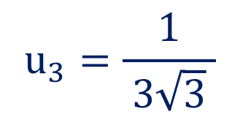
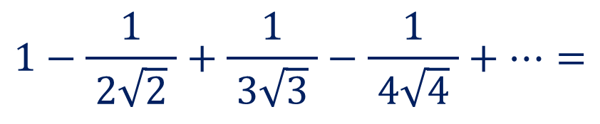
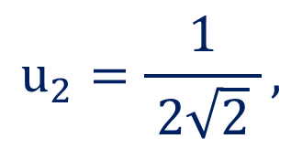
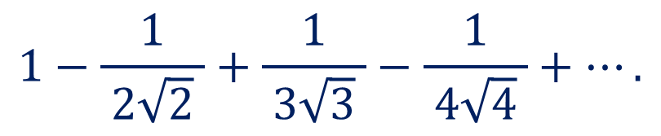

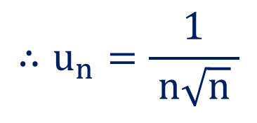
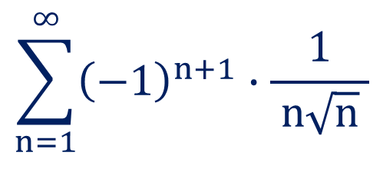

Method:14 Leibnitz’s Test
$$1−\frac{1}{ 2\sqrt{2} }+\frac{1}{ 3\sqrt{3} }−\frac{1}{ 4\sqrt{4} }+….$$
Example:1
Check the convergence of
$$\sum_{n=1}^{∞}{{\left(−1\right)}^{n+1}}∙\frac{1}{ n\sqrt{n} }$$
$$1−\frac{1}{ 2\sqrt{2} }+\frac{1}{ 3\sqrt{3} }−\frac{1}{ 4\sqrt{4} }+…=$$
Solution:
Here,
$$∴u_{n}=\frac{1}{ n\sqrt{n} }$$
$$u_{2}=\frac{1}{ 2\sqrt{2} },$$
$$u_{3}=\frac{1}{ 3\sqrt{3} }$$
Now,
$$u_{1}=1,$$
and so on.
$$∴u_{1}≥u_{2}≥u_{3}≥u_{4}≥…$$

Slide 6
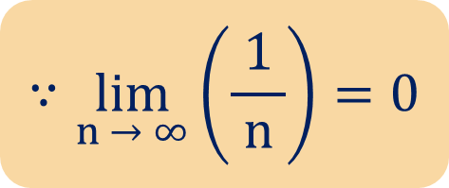


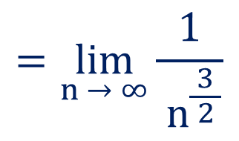
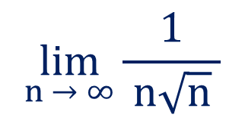
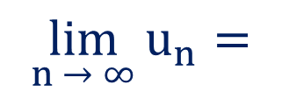
Method:14 $⇝$Example:1(Continue)
$$∴u_{1}≥u_{2}≥u_{3}≥u_{4}≥…$$
$$\lim_{n → ∞}{\frac{1}{ n\sqrt{n} }}$$
Now,
$$\lim_{n → ∞}{u_{n}}=$$
$$=\lim_{n → ∞}{\frac{1}{ n^{\frac{3}{ 2 }}}}$$
$$∵\lim_{n → ∞}\left(\frac{1}{ n }\right)=0$$
$$=0$$
Thus, by Leibnitz’s test, the given series is convergent.

Slide 7
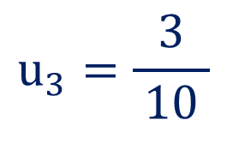
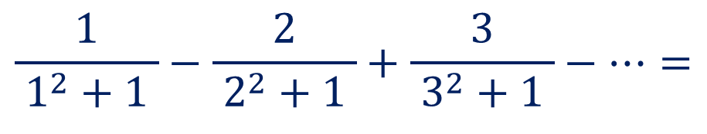
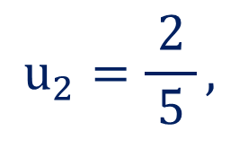
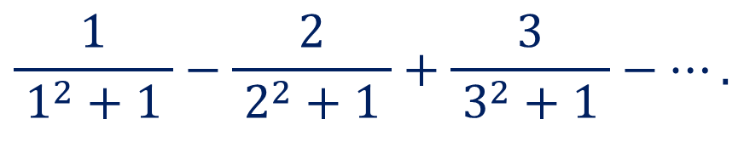
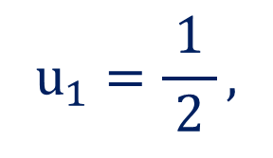
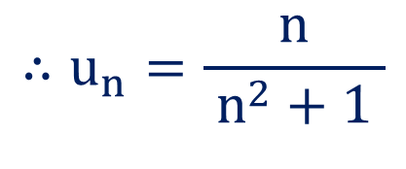
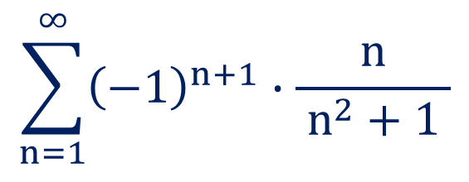

Method:14 Leibnitz’s Test
$$\frac{1}{ 1^{2}+1 }−\frac{2}{ 2^{2}+1 }+\frac{3}{ 3^{2}+1 }−….$$
Example:2
Check the convergence of
$$\sum_{n=1}^{∞}{{\left(−1\right)}^{n+1}}∙\frac{n}{ n^{2}+1 }$$
$$\frac{1}{ 1^{2}+1 }−\frac{2}{ 2^{2}+1 }+\frac{3}{ 3^{2}+1 }−…=$$
Solution:
Here,
$$∴u_{n}=\frac{n}{ n^{2}+1 }$$
$$u_{1}=\frac{1}{ 2 },$$
$$u_{2}=\frac{2}{ 5 },$$
$$u_{3}=\frac{3}{ 10 }$$
Now,
and so on.
$$∴u_{1}≥u_{2}≥u_{3}≥…$$

Slide 8
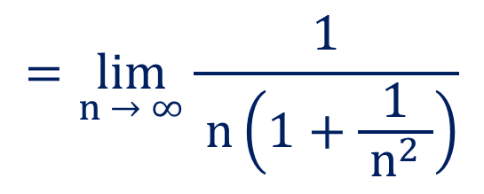


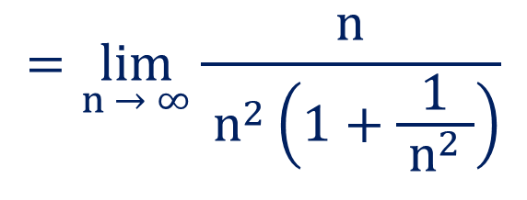
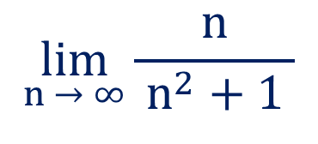
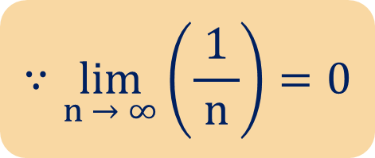
Method:14 $⇝$Example:2(Continue)
$$∴u_{1}≥u_{2}≥u_{3}≥…$$
$$\lim_{n → ∞}{\frac{n}{ n^{2}+1 }}$$
Now,
$$\lim_{n → ∞}{u_{n}}=$$
$$=\lim_{n → ∞}{\frac{n}{ n^{2}\left(1+\frac{1}{ n^{2} }\right)}}$$
$$=\lim_{n → ∞}{\frac{1}{ n\left(1+\frac{1}{ n^{2} }\right)}}$$
$$∵\lim_{n → ∞}\left(\frac{1}{ n }\right)=0$$
$$=0$$
Thus, by Leibnitz’s test, the given series is convergent.

Slide 9
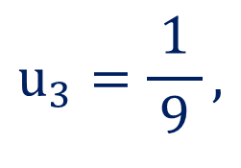
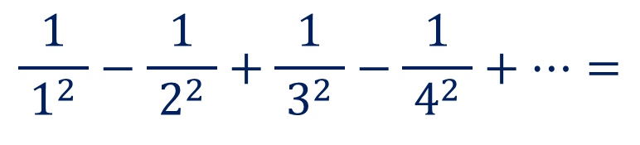
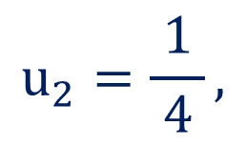
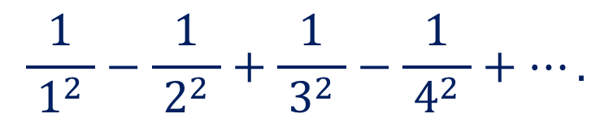

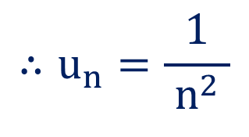
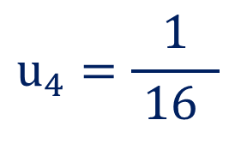
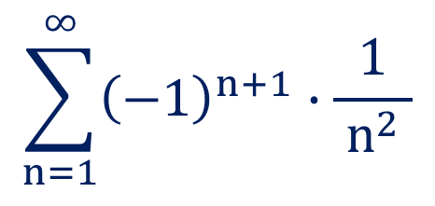

Method:14 Leibnitz’s Test
$$\frac{1}{ 1^{2} }−\frac{1}{ 2^{2} }+\frac{1}{ 3^{2} }−\frac{1}{ 4^{2} }+….$$
Example:3
Test the convergence of the series
$$\sum_{n=1}^{∞}{{\left(−1\right)}^{n+1}}∙\frac{1}{ n^{2} }$$
$$\frac{1}{ 1^{2} }−\frac{1}{ 2^{2} }+\frac{1}{ 3^{2} }−\frac{1}{ 4^{2} }+…=$$
Solution:
Here,
$$∴u_{n}=\frac{1}{ n^{2} }$$
$$u_{2}=\frac{1}{ 4 },$$
$$u_{3}=\frac{1}{ 9 },$$
$$u_{4}=\frac{1}{ 16 }$$
Now,
$$u_{1}=1,$$
and so on.
$$∴u_{1}≥u_{2}≥u_{3}≥u_{4}≥…$$

Slide 10




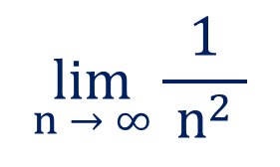

Method:14 $⇝$Example:3(Continue)
$$∴u_{1}≥u_{2}≥u_{3}≥u_{4}≥…$$
$∴\left\{u_{n}\right\}$ is decreasing.
$$\lim_{n → ∞}{\frac{1}{ n^{2} }}$$
Now,
$$\lim_{n → ∞}{u_{n}}=$$
$$∵\lim_{n → ∞}\left(\frac{1}{ n }\right)=0$$
$$=0$$
Thus, by Leibnitz’s test, the given series is convergent.

Slide 11
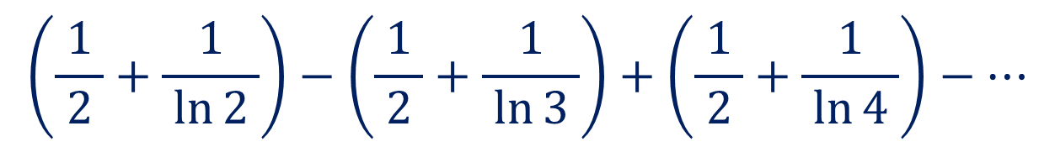
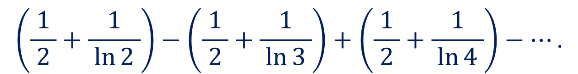
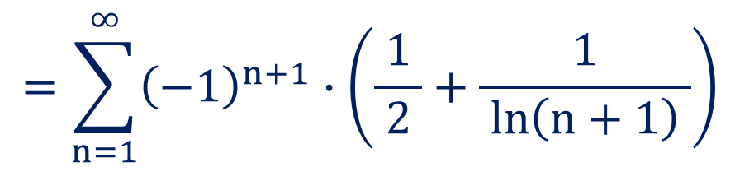
Method:14 Leibnitz’s Test
Example:4
Check the convergence of
$$\left(\frac{1}{ 2 }+\frac{1}{ \ln{2} }\right)−\left(\frac{1}{ 2 }+\frac{1}{ \ln{3} }\right)+\left(\frac{1}{ 2 }+\frac{1}{ \ln{4} }\right)−….$$
$$\left(\frac{1}{ 2 }+\frac{1}{ \ln{2} }\right)−\left(\frac{1}{ 2 }+\frac{1}{ \ln{3} }\right)+\left(\frac{1}{ 2 }+\frac{1}{ \ln{4} }\right)−…$$
Solution:
Here,
$$=\sum_{n=1}^{∞}{{\left(−1\right)}^{n+1}}∙\left(\frac{1}{ 2 }+\frac{1}{ \ln\left(n+1\right) }\right)$$

Slide 12
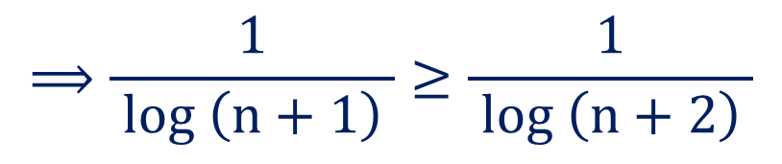
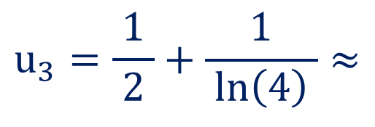

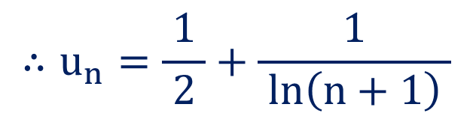
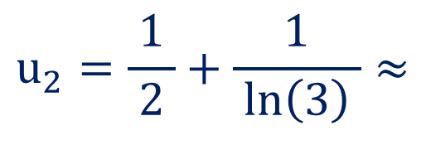


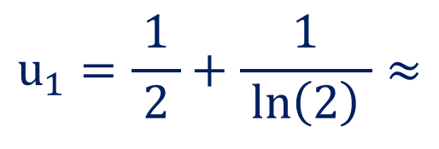


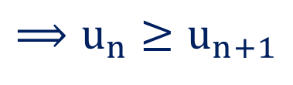

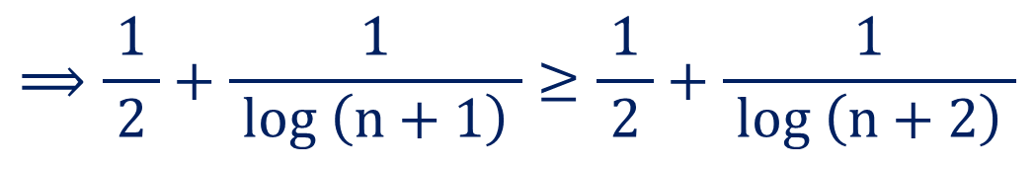

Method:14 $⇝$Example:4(Continue)
$$=\sum_{n=1}^{∞}{{\left(−1\right)}^{n+1}}∙\left(\frac{1}{ 2 }+\frac{1}{ \ln\left(n+1\right) }\right)$$
$$\left(n+1\right)≤\left(n+2\right)$$
$$;n∈\left(0,∞\right)$$
$$⟹log \left(n+1\right)≤log \left(n+2\right)$$
$$∴u_{n}=\frac{1}{ 2 }+\frac{1}{ \ln\left(n+1\right) }$$
$$⟹\frac{1}{ log \left(n+1\right) }≥\frac{1}{ log \left(n+2\right) }$$
$$u_{1}=\frac{1}{ 2 }+\frac{1}{ \ln\left(2\right) }≈$$
Now,
$$3.822$$
$$⟹\frac{1}{ 2 }+\frac{1}{ log \left(n+1\right) }≥\frac{1}{ 2 }+\frac{1}{ log \left(n+2\right) }$$
$$u_{2}=\frac{1}{ 2 }+\frac{1}{ \ln\left(3\right) }≈$$
$$2.595$$
$$⟹u_{n}≥u_{n+1}$$
$$u_{3}=\frac{1}{ 2 }+\frac{1}{ \ln\left(4\right) }≈$$
$$2.160$$
and so on.

Slide 13
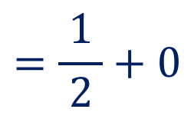


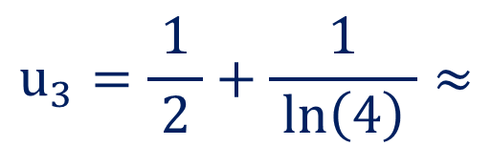
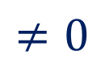
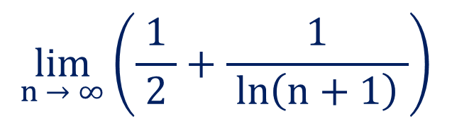
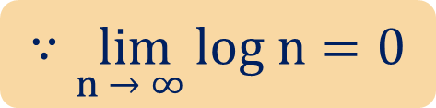

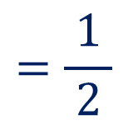
Method:14 $⇝$Example:4(Continue)
$$u_{3}=\frac{1}{ 2 }+\frac{1}{ \ln\left(4\right) }≈$$
$$2.160$$
and so on.
$$∴u_{1}≥u_{2}≥u_{3}≥u_{4}≥…$$
$$\lim_{n → ∞}\left(\frac{1}{ 2 }+\frac{1}{ \ln\left(n+1\right) }\right)$$
Now,
$$\lim_{n → ∞}{u_{n}}=$$
$$=\frac{1}{ 2 }+0$$
$$∵\lim_{n → ∞ }log n=0$$
$$=\frac{1}{ 2 }$$
$$≠0$$
Thus, by Leibnitz’s test, the given series is oscillating.

Slide 14
Method:15
Absolute Convergent Series

Slide 15


Method:15 Absolute Convergent Series
Absolute Convergent Series
$$\sum{a_{n}}$$
An alternating series
is said to be absolute convergent, if
$$\sum{|a_{n}|}$$
is convergent.
Note
An absolute convergent series is always convergent.

Slide 16
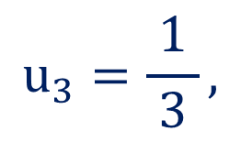









Method:15 Absolute Convergent Series
$$1−\frac{1}{ 2 }+\frac{1}{ 3 }−\frac{1}{ 4 }+\frac{1}{ 5 }−…$$
Example:1
Is series
convergent?
Does it converge absolutely?
$$=\sum_{n=1}^{∞}{\frac{ {\left(−1\right)}^{n+1} }{n}}$$
$$1−\frac{1}{ 2 }+\frac{1}{ 3 }−\frac{1}{ 4 }+\frac{1}{ 5 }−…$$
Solution:
$$1)$$
Here,
$$∴u_{n}=\frac{1}{ n }$$
$$u_{2}=\frac{1}{ 2 },$$
$$u_{3}=\frac{1}{ 3 },$$
$$u_{4}=\frac{1}{ 4 }$$
Now,
$$u_{1}=1,$$
and so on.
$$∴u_{1}≥u_{2}≥u_{3}≥u_{4}≥…$$

Slide 17








Method:15 $⇝$Example:1(Continue)
$$∴u_{1}≥u_{2}≥u_{3}≥u_{4}≥…$$
$$\lim_{n → ∞}{\frac{1}{ n }}$$
Now,
$$\lim_{n → ∞}{u_{n}}=$$
$$=0$$
Thus, by Leibnitz’s test, the given series is convergent.
$$=\sum_{n=1}^{∞}{\frac{ {\left(−1\right)}^{n+1} }{n}}$$
$$1−\frac{1}{ 2 }+\frac{1}{ 3 }−\frac{1}{ 4 }+\frac{1}{ 5 }−…$$
$$2)$$
Here,
$$∴a_{n}=\frac{ {\left(−1\right)}^{n+1} }{n}$$

Slide 18





Method:15 $⇝$Example:1(Continue)
$$∴a_{n}=\frac{ {\left(−1\right)}^{n+1} }{n}$$
Let, $w_{n}=\left|a_{n}\right|$
$$∴w_{n}=\frac{1}{ n }$$
$$\sum_{n=1}^{∞}{w_{n}}=\sum_{n=1}^{∞}{\frac{1}{ n }}$$
Now,
is divergent by $p$-series test, as $p=1.$
Thus, the given series does not converges absolutely.

Slide 19








Method:15 Absolute Convergent Series
Example:2
Determine the absolute convergence
$$1−2x+3x^{2}−4x^{3}+…$$
$$\left(0≤x<1\right)$$
$$=\sum_{n=1}^{∞}{{\left(−1\right)}^{n+1}}∙n∙x^{n−1}$$
Solution:
Here,
$$1−2x+3x^{2}−4x^{3}+…$$
$$∴a_{n}={\left(−1\right)}^{n+1}∙n∙x^{n−1}$$
Let, $w_{n}=\left|a_{n}\right|$
$$∴w_{n}=n∙x^{n−1}$$
$$⟹w_{n+1}=\left(n+1\right)∙x^{n}$$

Slide 20












Method:15 $⇝$Example:2(Continue)
$$∴w_{n}=n∙x^{n−1}$$
$$⟹w_{n+1}=\left(n+1\right)∙x^{n}$$
$$∴\lim_{n → ∞}{\frac{w_{n}}{ w_{n+1} }}=\frac{1}{ x }$$
$$>1$$
$$\lim_{n → ∞}{\frac{w_{n}}{ w_{n+1} }}=$$
$$\lim_{n → ∞}{\frac{n∙x^{n−1}}{ \left(n+1\right)∙x^{n} }}$$
Now,
Thus, by Ratio test,
$$\sum_{n=1}^{∞}{w_{n}}$$
$$=\lim_{n → ∞}{\frac{n∙x^{n}∙x^{−1}}{ n∙\left(1+\frac{1}{ n }\right)∙x^{n} }}$$
is convergent.
$$=\frac{1}{ x }$$
$$\sum_{n=1}^{∞}{a_{n}}$$
Hence,
Given that, $0≤x<1$
converges absolutely.
$$∴\frac{1}{ x }>1$$

Slide 21






Method:15 Absolute Convergent Series
$$(1)\sum_{n=1}^{∞}{\frac{ {\left(−1\right)}^{n−1} }{n^{p}}} \left(p>1\right)$$
Example:3
Determine the absolute convergence of
$$a_{n}=\frac{ {\left(−1\right)}^{n−1} }{n^{p}}$$
Solution:
Here,
Let, $w_{n}=\left|a_{n}\right|$
$$∴w_{n}=\frac{1}{ n^{p} }$$
$$\sum_{n=1}^{∞}{w_{n}}=\sum_{n=1}^{∞}{\frac{1}{ n^{p} }}$$
Now,
and given that $p>1$

Slide 22




Method:15 $⇝$Example:3(1)(Continue)
$$\sum_{n=1}^{∞}{w_{n}}=\sum_{n=1}^{∞}{\frac{1}{ n^{p} }}$$
Now,
and given that $p>1$
$$\sum_{n=1}^{∞}{w_{n}}=\sum_{n=1}^{∞}{|a_{n}|}$$
So, by $p$-series test,
is convergent.
Thus, the given series converges absolutely.

Slide 23






Method:15 Absolute Convergent Series
$$(2)\sum_{n=1}^{∞}{{\left(−1\right)}^{n+1}}\left(\frac{\sin{n} }{n^{2}}\right)$$
Example:3
Determine the absolute convergence of
$$a_{n}={\left(−1\right)}^{n+1}\left(\frac{\sin{n} }{n^{2}}\right)$$
Solution:
Here,
Let, $w_{n}=\left|a_{n}\right|$
$$∴w_{n}=\frac{| sin{n}| }{n^{2}}$$
We know that, $−1≤\sin{n}≤1$
$$⟹0≤| sin{n}|≤1$$

Slide 24






Method:15 $⇝$Example:3(2)(Continue)
$$⟹0≤| sin{n}|≤1$$
$$⟹0≤\frac{| sin{n}| }{n^{2}}≤\frac{1}{ n^{2} }$$
$$\sum_{n=1}^{∞}{\frac{1}{ n^{2} }}$$
Since,
is convergent by $p$-series test, as $p=2>1$
$$⟹\sum_{n=1}^{∞}{\frac{| sin{n}| }{n^{2}}}$$
is convergent by direct comparison test.
$$⟹\sum_{n=1}^{∞}{w_{n}}=\sum_{n=1}^{∞}{|a_{n}|}$$
is convergent.

Slide 25


Method:15 $⇝$Example:3(2)(Continue)
$$⟹\sum_{n=1}^{∞}{w_{n}}=\sum_{n=1}^{∞}{|a_{n}|}$$
is convergent.
$$\sum_{n=1}^{∞}{a_{n}}=\sum_{n=1}^{∞}{{\left(−1\right)}^{n+1}}\left(\frac{\sin{n} }{n^{2}}\right)$$
Thus,
is absolutely convergent.

Slide 26
Method:16
Conditionally Convergent Series

Slide 27




Method:16 Conditionally Convergent Series
Conditionally Convergent Series
$$\sum{a_{n}}$$
An alternating series
is said to be conditionally convergent, if
$$\sum{a_{n}}$$
$$1)$$
is convergent.
$$\sum{\left|a_{n}\right|}$$
$$2)$$
is divergent.
Note
Infinite series can not be absolute and conditionally convergent
together.

Slide 28







Method:16 Conditionally Convergent Series
$$\sum_{n=1}^{∞}{\frac{ {\left(−1\right)}^{n+1} }{\sqrt[3]{n}}}.$$
Example:1
Check the absolute and conditionally convergence of
$$a_{n}=\frac{ {\left(−1\right)}^{n+1} }{\sqrt[3]{n}}$$
Solution:
Here,
$$\sum{a_{n}}$$
$$1)$$
is convergent.
$$u_{n}=\frac{ 1 }{\sqrt[3]{n}}$$
$$\sum{\left|a_{n}\right|}$$
Let,
$$2)$$
is divergent.
$$∴u_{n}=\frac{1}{n^{\frac{1}{ 3 }}}$$

Slide 29








Method:16 $⇝$Example:1(Continue)
$$∴u_{n}=\frac{1}{n^{\frac{1}{ 3 }}}$$
$$u_{2}=\frac{1}{ 2^{\frac{1}{ 3 }} },$$
$$u_{3}=\frac{1}{ 3^{\frac{1}{ 3 }} }$$
Now,
$$u_{1}=1,$$
and so on.
$$∴u_{1}≥u_{2}≥u_{3}≥…$$
$$\lim_{n → ∞}{\frac{1}{ n^{\frac{1}{ 3 }} }}$$
Now,
$$\lim_{n → ∞}{u_{n}}=$$
$$=0$$
$$\sum_{n=1}^{∞}{a_{n}}$$
Thus, by Leibnitz’s test,
is convergent.

Slide 30









Method:16 $⇝$Example:1(Continue)
$$\sum_{n=1}^{∞}{a_{n}}$$
Thus, by Leibnitz’s test,
is convergent.
$$\sum_{n=1}^{∞}{\left|a_{n}\right|}=$$
$$\sum_{n=1}^{∞}{\left|\frac{ {\left(−1\right)}^{n+1} }{\sqrt[3]{n}}\right|}$$
Now,
$$\sum{a_{n}}$$
$$1)$$
is convergent.
$$=\sum_{n=1}^{∞}{\frac{1}{ \sqrt[3]{n} }}$$
$$\sum{\left|a_{n}\right|}$$
$$2)$$
is divergent.
$$=\sum_{n=1}^{∞}{\frac{1}{ n^{\frac{1}{ 3 }}}}$$
is divergent by $p$-series test, as $p=\frac{1}{ 3 }<1.$

Slide 31




Method:16 $⇝$Example:1(Continue)
$$=\sum_{n=1}^{∞}{\frac{1}{ n^{\frac{1}{ 3 }}}}$$
is divergent by $p$-series test, as $p=\frac{1}{3}<1.$
$$\sum_{n=1}^{∞}{a_{n}}$$
$$\sum_{n=1}^{∞}{\left|a_{n}\right|}$$
Thus,
is convergent and
is divergent.
Hence, the given series is conditionally convergent.

Slide 32













Method:16 Conditionally Convergent Series
$$−\frac{1}{ 1^{p} }+\frac{1}{ 2^{p} }−\frac{1}{ 3^{p} }+\frac{1}{ 4^{p} }−…;$$
Example:2
Check the convergence of
$$p>0$$
$$\sum_{n=1}^{∞}{{\left(−1\right)}^{n}\frac{1}{ n^{p} }}.$$
$$−\frac{1}{ 1^{p} }+\frac{1}{ 2^{p} }−\frac{1}{ 3^{p} }+\frac{1}{ 4^{p} }−…=$$
Solution:
Here
$$a_{n}={\left(−1\right)}^{n}\frac{1}{ n^{p} }$$
$$\sum{a_{n}}$$
Here,
$$1)$$
is convergent.
$$u_{n}=\frac{ 1 }{ n^{p} }$$
$$\sum{\left|a_{n}\right|}$$
Let,
$$2)$$
is divergent.
$$u_{1}=\frac{1}{ n^{p} },$$
$$u_{2}=\frac{1}{ 2^{p} },$$
$$u_{3}=\frac{1}{ 3^{p} }$$
Now,
and so on.

Slide 33










Method:16 $⇝$Example:2(Continue)
$$u_{1}=\frac{1}{n^{p}},$$
$$u_{2}=\frac{1}{ 2^{p} },$$
$$u_{3}=\frac{1}{ 3^{p} }$$
Now,
and so on.
$$∴u_{1}≥u_{2}≥u_{3}≥…$$
$$\left(∵p>0\right)$$
$$\lim_{n → ∞}{\frac{1}{ n^{p} }}$$
Now,
$$\lim_{n → ∞}{u_{n}}=$$
$$=0$$
as $p>0$
$$\sum_{n=1}^{∞}{a_{n}}$$
Thus, by Leibnitz’s test,
is convergent.

Slide 34





Method:16 $⇝$Example:2(Continue)
$$\sum_{n=1}^{∞}{a_{n}}$$
Thus, by Leibnitz’s test,
is convergent.
$$\sum_{n=1}^{∞}{\left|a_{n}\right|}=$$
$$\sum_{n=1}^{∞}{\left|\frac{ { \left(−1\right)}^{n} }{n^{p}}\right|}$$
Now,
$$=\sum_{n=1}^{∞}{\frac{1}{ n^{p} }}$$
Given that, $p>0.$

Slide 35








Method:16 $⇝$Example:2(Continue)
Given that, $p>0.$
Case:1
If $p>1$
$$\sum_{n=1}^{∞}{\frac{1}{ n^{p} }}$$
is convergent by $p$-series test, as $p>1.$
The given series is absolutely convergent for $p>1$ and is not conditionally
convergent when $p>1$.
$$\sum_{n=1}^{∞}{\frac{1}{ n^{p} }}$$
Case:2
If $0<p≤1,$
is divergent by $p$-series test, as $0<p≤1.$

Slide 36




Method:16 $⇝$Example:2(Continue)
$$\sum_{n=1}^{∞}{\frac{1}{ n^{p} }}$$
Case:2
If $0<p≤1$
is divergent by $p$-series test, as $0<p≤1.$
Thus, the given series is conditionally convergent for $0<p≤1$.
Conclusion
The given series is absolutely convergent for $p>1$ and
conditionally convergent for $0<p≤1.$

Slide 37
Method:17
Power Series

Slide 38


Method:17 Power Series
Power Series
An infinite series of the form
$$\sum_{n=0}^{∞}{a_{n}}{\left(x−c\right)}^{n}=$$
$$a_{0}+a_{1}\left(x−c\right)+a_{2}{\left(x−c\right)}^{2}+a_{3}{\left(x−c\right)}^{3}+…$$
is known as power series, where $a_{n}$ is the co-efficient of the $n^{th}$ term,
$c$ is a constant and $x$ varies around $c.$
The series is also known as power series about $x=c.$

Slide 39




Method:17 Power Series
Power Series
$$\sum_{n=0}^{∞}{a_{n}}{\left(x−c\right)}^{n}=$$
$$a_{0}+a_{1}\left(x−c\right)+a_{2}{\left(x−c\right)}^{2}+a_{3}{\left(x−c\right)}^{3}+…$$
If $c=0$ then, it is called power series in terms of $x.$
$$\sum_{n=0}^{∞}{a_{n}}{\left(x\right)}^{n}=$$
$$a_{0}+a_{1}x+a_{2}x^{2}+a_{3}x^{3}+…$$

Slide 40



Method:17 Power Series
Radius & Interval of Convergence for Power Series
$$\sum_{n=0}^{∞}{a_{n}}{\left(x−c\right)}^{n}$$
Let
be a power series about $x=c$ and $\left|x−c\right|<R$
$$R=\lim_{n → ∞}\left|\frac{a_{n}}{ a_{n+1} }\right|$$
where,
Then, $R$ called radius of convergence and $\left(c−R, c+R\right)$ is called
interval of convergence.

Slide 41


Method:17 Power Series
Radius & Interval of Convergence for Power Series
An interval in which power series converges is called the interval of
convergence and the half length of the interval of convergence is
called the radius of convergence.
Radius of the convergence for a power series can be obtained from
either of the formulae as follows:
$$R=\lim_{n → ∞}\left|\frac{a_{n}}{ a_{n+1} }\right|$$
$$R=\lim_{n → ∞}{\frac{1}{{\left(a_{n}\right)}^{\frac{1}{ n }}}}$$
OR

Slide 42







Method:17 Power Series
Convergence of Power Series
$$\sum_{n=0}^{∞}{a_{n}}{\left(x−c\right)}^{n}$$
Let
be a power series. Then exactly one of the following
conditions hold:
$$1)$$
The series always converges at $x=0.$
$$2)$$
The series always converges for all $x$.
$$3)$$
There exists a positive number $R$ such that series converges for
$\left|x−c\right|<R$and diverges for $\left|x−c\right|>R.$

Slide 43
NOTES
If a power series is convergent for all values of $x,$ then interval of convergence
will be $\left(−∞,∞\right)$ and the radius of convergence will be $∞.$
For any $x$, outside the interval $\left(x−R,x+R\right),$ a power series diverges.

Slide 44




Method:17 Power Series
Example:1
Find the radius of convergence and interval of convergence of
$$1−\frac{1}{ 2 }\left(x−2\right)+\frac{1}{ 2^{2} }{\left(x−2\right)}^{2}+…+{\left(−\frac{1}{ 2 }\right)}^{n}{\left(x−2\right)}^{n}+….$$
$$−1−\frac{1}{ 2 }\left(x−2\right)+\frac{1}{ 2^{2} }{\left(x−2\right)}^{2}+…+{\left(−\frac{1}{ 2 }\right)}^{n}{\left(x−2\right)}^{n}+…$$
Solution:
Here
$$=\sum_{n=1}^{∞}{{\left(−\frac{1}{ 2 }\right)}^{n}{\left(x−2\right)}^{n}}$$
$$a_{n}={\left(−\frac{1}{ 2 }\right)}^{n}{\left(x−2\right)}^{n}$$
Here,

Slide 45




Method:17 $⇝$Example:1(Continue)
$$a_{n}={\left(−\frac{1}{ 2 }\right)}^{n}{\left(x−2\right)}^{n}$$
Here,
$$⟹a_{n+1}={\left(−\frac{1}{ 2 }\right)}^{n+1}{\left(x−2\right)}^{n+1}$$
$$\lim_{n → ∞}\left|\frac{{\left(−\frac{1}{ 2 }\right)}^{n}{\left(x−2\right)}^{n}}{{\left(−\frac{1}{ 2 }\right)}^{n+1}{\left(x−2\right)}^{n+1}}\right|$$
$$\lim_{n → ∞}\left|\frac{a_{n}}{ a_{n+1} }\right|=$$
Now,

Slide 46




Method:17 $⇝$Example:1(Continue)
$$\lim_{n → ∞}\left|\frac{{\left(−\frac{1}{ 2 }\right)}^{n}{\left(x−2\right)}^{n}}{{\left(−\frac{1}{ 2 }\right)}^{n+1}{\left(x−2\right)}^{n+1}}\right|$$
$$\lim_{n → ∞}\left|\frac{a_{n}}{ a_{n+1} }\right|=$$
Now,
$$=\lim_{n → ∞}\left|\frac{{\left(−\frac{1}{ 2 }\right)}^{n}{\left(x−2\right)}^{n}}{{\left(−\frac{1}{ 2 }\right)}^{n}\left(−\frac{1}{ 2 }\right){\left(x−2\right)}^{n}\left(x−2\right)}\right|$$
$$=\lim_{n → ∞}\left|\frac{1}{\left(−\frac{1}{ 2 }\right)\left(x−2\right)}\right|$$

Slide 47





Method:17 $⇝$Example:1(Continue)
$$=\lim_{n → ∞}\left|\frac{1}{\left(−\frac{1}{ 2 }\right)\left(x−2\right)}\right|$$
$$=\left|\frac{−2}{\left(x−2\right)}\right|$$
$$=\frac{2}{ \left|x−2\right| }$$
$$\frac{2}{ \left|x−2\right| }>1$$
Now, by ratio test the given series is convergent, if
$$⟹2>\left|x−2\right|$$

Slide 48














Method:17 $⇝$Example:1(Continue)
$$⟹2>\left|x−2\right|$$
$$⟹a_{n}=\frac{{(−1)}^{n}}{2^{n}}{{\left(−1\right)}^{n}\left(2\right)}^{n}$$
$$⟹\left|x−2\right|<2$$
$$=R$$
$$⟹a_{n}=1$$
$$⟹−2<x−2<2$$
$$\sum_{n=1}^{∞}{1}$$
$$⟹0<x<4$$
Now,
is divergent.
$$a_{n}={\left(−\frac{1}{ 2 }\right)}^{n}{\left(x−2\right)}^{n}$$
At $x=0$
$$a_{n}={\left(−\frac{1}{ 2 }\right)}^{n}{\left(−2\right)}^{n}$$
At $x=4$
$$a_{n}={\left(−\frac{1}{ 2 }\right)}^{n}{\left(2\right)}^{n}$$
$$⟹a_{n}={\left(−1\right)}^{n}$$

Slide 49





Method:17 $⇝$Example:1(Continue)
$$⟹a_{n}={\left(−1\right)}^{n}$$
$$\sum_{n=1}^{∞}{{\left(−1\right)}^{n}}$$
Now,
is not convergent.
Thus, the interval of convergence is $0<x<4.$
i.e. $\left(0,4\right)$
and the radius of convergence $R=2.$

Slide 50






Method:17 Power Series
Example:2
Find the radius of convergence and interval of convergence of
$$\sum_{n=0}^{∞}{n!}∙x^{n}$$
Solution:
Here,
$$a_{n}=n!x^{n}$$
$$⟹a_{n+1}=\left(n+1\right)!x^{n+1}$$
$$\lim_{n → ∞}\left|\frac{a_{n}}{ a_{n+1} }\right|=$$
$$\lim_{n → ∞}\left|\frac{n!x^{n}}{\left(n+1\right)!x^{n+1}}\right|$$
Now,
$$=\lim_{n → ∞}\left|\frac{1}{n\left(1+\frac{1}{ n }\right)x}\right|$$

Slide 51


Method:17 $⇝$Example:2(Continue)
$$=\lim_{n → ∞}\left|\frac{1}{n\left(1+\frac{1}{ n }\right)x}\right|$$
$$=0$$
Thus, the series converges only when $x=0$ and diverges for all $x≠0.$
Hence, radius of convergence $R=0$ and there is no interval of convergence.

Slide 52





Method:17 Power Series
Example:3
Find the radius of convergence and interval of convergence of
$$\sum_{n=0}^{∞}{\frac{x^{2n−1}}{ \left(2n−1\right)! }}$$
$$a_{n}=\frac{x^{2n−1}}{ \left(2n−1\right)! }$$
$$⟹a_{n+1}=\frac{x^{2n+1}}{ \left(2n+1\right)! }$$
Solution:
Here,
$$\lim_{n → ∞}\left|\frac{a_{n}}{ a_{n+1} }\right|=$$
$$\lim_{n → ∞}\left|\frac{ x^{2n−1}\left(2n+1\right)! }{\left(2n−1\right)!x^{2n+1}}\right|$$
Now,

Slide 53





Method:17 $⇝$Example:3(Continue)
$$\lim_{n → ∞}\left|\frac{a_{n}}{ a_{n+1} }\right|=$$
$$\lim_{n → ∞}\left|\frac{ x^{2n−1}\left(2n+1\right)! }{\left(2n−1\right)!x^{2n+1}}\right|$$
Now,
$$=\lim_{n → ∞}\left|\frac{ x^{2n}x^{−1}\left(2n+1\right)\left(2n\right)\left(2n−1\right)! }{\left(2n−1\right)!x^{2n}∙x}\right|$$
$$=\lim_{n → ∞}\left|\frac{ \left(2n+1\right)\left(2n\right) }{x^{2}}\right|$$
$$=\lim_{n → ∞}\left|\frac{ 4n^{2}\left(1+\frac{1}{ 2n }\right) }{x^{2}}\right|$$

Slide 54




Method:17 $⇝$Example:3(Continue)
$$=\lim_{n → ∞}\left|\frac{ 4n^{2}\left(1+\frac{1}{ 2n }\right) }{x^{2}}\right|$$
$$=∞$$
Thus, radius of convergence $R:∞$
and interval of convergence: $\left(−∞, ∞\right)$

Slide 55





Method:17 Power Series
$$\sum_{n=1}^{∞}{{\left(−1\right)}^{n}}∙\frac{{\left(x+2\right)}^{n}}{n}$$
Example:4
For the series
find the radius and interval of
convergence. For what values of $x$ does the series converges
absolutely, conditionally ?
$$a_{n}={\left(−1\right)}^{n}\frac{{\left(x+2\right)}^{n}}{n}$$
$$⟹a_{n+1}={\left(−1\right)}^{n+1}\frac{{\left(x+2\right)}^{n+1}}{n+1}$$
Solution:
Here,
$$\lim_{n → ∞}\left|\frac{a_{n}}{ a_{n+1} }\right|=$$
$$\lim_{n → ∞}\left|\frac{{\left(−1\right)}^{n}{\left(x+2\right)}^{n}}{n}∙\frac{n+1}{{\left(−1\right)}^{n+1}{\left(x+2\right)}^{n+1}}\right|$$
Now,

Slide 56





Method:17 $⇝$Example:4(Continue)
$$\lim_{n → ∞}\left|\frac{a_{n}}{ a_{n+1} }\right|=$$
$$\lim_{n → ∞}\left|\frac{{\left(−1\right)}^{n}{\left(x+2\right)}^{n}}{n}∙\frac{n+1}{{\left(−1\right)}^{n+1}{\left(x+2\right)}^{n+1}}\right|$$
Now,
$$=\lim_{n → ∞}\left|\frac{{\left(−1\right)}^{n}{\left(x+2\right)}^{n}}{n}∙\frac{n+1}{{\left(−1\right)}^{n}\left(−1\right){\left(x+2\right)}^{n}\left(x+2\right)}\right|$$
$$=\lim_{n → ∞}\left|\frac{n\left(1+\frac{1}{ n }\right)}{n\left(−1\right)\left(x+2\right)}\right|$$
$$=\frac{1}{ \left|x+2\right| }$$

Slide 57






Method:17 $⇝$Example:4(Continue)
$$=\frac{1}{ \left|x+2\right| }$$
$$\frac{1}{ \left|x+2\right| }>1$$
Now, by ratio test the given series is convergent, if
$$⟹1>\left|x+2\right|$$
$$⟹\left|x+2\right|<1=R$$
$$⟹−1<x+2<1$$
$$⟹−3<x<−1$$

Slide 58







Method:17 $⇝$Example:4(Continue)
$$⟹−3<x<−1$$
$$a_{n}={\left(−1\right)}^{n}\frac{{\left(x+2\right)}^{n}}{n}$$
At $x=−3$
$$a_{n}=\frac{{\left(−1\right)}^{n}{\left(−1\right)}^{n}}{n}$$
$$a_{n}=\frac{1}{ n }$$
$$\sum_{n=0}^{∞}{\frac{1}{ n }}$$
Now,
is divergent by $p$-series test as $p=1$.

Slide 59









Method:17 $⇝$Example:4(Continue)
At $x=−1$
$$a_{n}=\frac{{\left(−1\right)}^{n}{\left(1\right)}^{n}}{n}$$
$$=\frac{{\left(−1\right)}^{n}}{n}$$
$$u_{n}=\frac{ 1 }{ n }$$
Let,
$$u_{2}=\frac{1}{ 2 },$$
$$u_{3}=\frac{1}{ 3 }$$
Now,
$$u_{1}=1,$$
and so on.
$$∴u_{1}≥u_{2}≥u_{3}≥…$$
$$\lim_{n → ∞}{\frac{1}{ n }}$$
Now,
$$\lim_{n → ∞}{u_{n}}=$$

Slide 60







Method:17 $⇝$Example:4(Continue)
$$\lim_{n → ∞}{\frac{1}{ n }}$$
Now,
$$\lim_{n → ∞}{u_{n}}=$$
$$=0$$
$$\sum_{n=1}^{∞}{a_{n}}$$
Thus, by Leibnitz’s test,
is convergent for $x=−1$
Thus, radius of convergence $R:1$as$\left|x+2\right|<1$
and interval of convergence: $\left(−3,−1\right]$
$$\sum_{n=1}^{∞}{a_{n}}$$
Now,
is convergent for $x=−1$

Slide 61





Method:17 $⇝$Example:4(Continue)
$$\sum_{n=1}^{∞}{a_{n}}$$
Now,
is convergent for $x=−1$
$$\sum_{n=1}^{∞}{a_{n}=}$$
$$\sum_{n=1}^{∞}{\frac{{\left(−1\right)}^{n}}{n}}$$
$$\sum{a_{n}}$$
$$1)$$
is convergent.
where,
$$\sum{\left|a_{n}\right|}$$
$$2)$$
is divergent.
$$\sum_{n=1}^{∞}{\left|a_{n}\right|}=$$
$$\sum_{n=1}^{∞}{\left|\frac{ { \left(−1\right)}^{n} }{n}\right|}$$
Now,
$$=\sum_{n=1}^{∞}{\frac{1}{ n }}$$
is divergent by $p$-series test, as $p=1.$

Slide 62



Method:17 $⇝$Example:4(Continue)
$$=\sum_{n=1}^{∞}{\frac{1}{ n }}$$
is divergent by $p$-series test, as $p=1.$
Thus, the given series is conditionally convergent at $x=−1.$
Conclusion
The given series is absolutely convergent in $\left(−3,−1\right)$ and
conditionally convergent at $x=−1.$

Slide 63

Method:18
$1^{st}$ form of Taylor’s Series

Slide 64


Method:18 $1^{st}$ Form of Taylor’s Series
Taylor’s Series: $1^{st}$ Form
If $f\left(x\right)$ possesses derivatives of all order at a point ‘$a$’, then Taylor’s
series of given function $f\left(x\right)$ at a point ‘$a$’, is given by
$$f\left(x\right) =f\left(a\right)+\frac{f^{′}\left(a\right)}{1!}\left(x−a\right)+\frac{f^{′′}\left(a\right)}{2!}{\left(x−a\right)}^{2}+\frac{f^{′′′}\left(a\right)}{3!}{\left(x−a\right)}^{3}+…$$

Slide 65




Method:18 $1^{st}$ Form of Taylor’s Series
Example:1
Expand $e^{x}$ in power of $\left(x−1\right)$ up to first four terms.
Solution:
Here,
$$f\left(x\right)=e^{x}$$
By Taylor’s Series,
$$f\left(x\right) =f\left(a\right)+\frac{f^{′}\left(a\right)}{1!}\left(x−a\right)+\frac{f^{′′}\left(a\right)}{2!}{\left(x−a\right)}^{2}+\frac{f^{′′′}\left(a\right)}{3!}{\left(x−a\right)}^{3}+…$$
Now, putting $a=1$
$$f\left(x\right) =f\left(1\right)+\frac{f^{′}\left(1\right)}{1!}\left(x−1\right)+\frac{f^{′′}\left(1\right)}{2!}{\left(x−1\right)}^{2}+\frac{f^{′′′}\left(1\right)}{3!}{\left(x−1\right)}^{3}+…$$
$$\left(1\right)$$

Slide 66
















Method:18 $⇝$Example:1(Continue)
$$f\left(x\right) =f\left(1\right)+\frac{f^{′}\left(1\right)}{1!}\left(x−1\right)+\frac{f^{′′}\left(1\right)}{2!}{\left(x−1\right)}^{2}+\frac{f^{′′′}\left(1\right)}{3!}{\left(x−1\right)}^{3}+…$$
$$\left(1\right)$$
Here,
$$f\left(x\right)=e^{x}$$
$$⟹f\left(1\right)=$$
$$e$$
$$f^{′′}\left(x\right)=e^{x}$$
$$⟹f^{′′}\left(1\right)=$$
$$e$$
$$f^{′}\left(x\right)=e^{x}$$
$$⟹f^{′}\left(1\right)=$$
$$e$$
$$f^{′′′}\left(x\right)=e^{x}$$
$$⟹f^{′′′}\left(1\right)=$$
$$e$$
and so on.
From equation $\left(1\right),$
$$f\left(x\right) =e+\frac{e}{1!}\left(x−1\right)+\frac{e}{2!}{\left(x−1\right)}^{2}+\frac{e}{3!}{\left(x−1\right)}^{3}+…$$
$$∴e^{x}=e\left[1+\frac{1}{1!}\left(x−1\right)+\frac{1}{2!}{\left(x−1\right)}^{2}+\frac{1}{3!}{\left(x−1\right)}^{3}+…\right]$$

Slide 67



Method:18 $1^{st}$ Form of Taylor’s Series
Example:2
Express $f\left(x\right)=2x^{3}+3x^{2}−8x+7$ in terms of $\left(x−2\right).$
Solution:
Here,
$$f\left(x\right)=2x^{3}+3x^{2}−8x+7$$
By Taylor’s Series,
$$f\left(x\right) =f\left(a\right)+\frac{f^{′}\left(a\right)}{1!}\left(x−a\right)+\frac{f^{′′}\left(a\right)}{2!}{\left(x−a\right)}^{2}+\frac{f^{′′′}\left(a\right)}{3!}{\left(x−a\right)}^{3}+…$$
Now, putting $a=2$
$$f\left(x\right) =f\left(2\right)+\frac{f^{′}\left(2\right)}{1!}\left(x−2\right)+\frac{f^{′′}\left(2\right)}{2!}{\left(x−2\right)}^{2}+\frac{f^{′′′}\left(2\right)}{3!}{\left(x−2\right)}^{3}+…$$
$$\left(1\right)$$

Slide 68
















Method:18 $⇝$Example:2(Continue)
$$f\left(x\right) =f\left(2\right)+\frac{f^{′}\left(2\right)}{1!}\left(x−2\right)+\frac{f^{′′}\left(2\right)}{2!}{\left(x−2\right)}^{2}+\frac{f^{′′′}\left(2\right)}{3!}{\left(x−2\right)}^{3}+…$$
$$\left(1\right)$$
Here,
$$f\left(x\right)={2x}^{3}+3x^{2}−8x+7$$
$$⟹f\left(2\right)=$$
$$16+12−16+7=$$
$$19$$
$$f^{′}\left(x\right)=6x^{2}+6x−8$$
$$⟹f^{′}\left(2\right)=$$
$$24+12−8=$$
$$28$$
$$f^{′′}\left(x\right)=12x+6$$
$$⟹f^{′′}\left(2\right)=$$
$$24+6=$$
$$30$$
$$f^{′′′}\left(x\right)=12$$
$$⟹f^{′′′}\left(2\right)=$$
$$12$$

Slide 69



Method:18 $⇝$Example:2(Continue)
From equation $\left(1\right),$
$$f\left(x\right) =19+\frac{28}{1!}\left(x−2\right)+\frac{30}{2!}{\left(x−2\right)}^{2}+\frac{12}{3!}{\left(x−2\right)}^{3}$$
$$f\left(x\right) =19+\frac{28}{1!}\left(x−2\right)+\frac{30}{2!}{\left(x−2\right)}^{2}+\frac{12}{3!}{\left(x−2\right)}^{3}$$
$$f\left(x\right) =19+28\left(x−2\right)+15{\left(x−2\right)}^{2}+2{\left(x−2\right)}^{3}$$

Slide 70



Method:18 $1^{st}$ Form of Taylor’s Series
Example:3
Find the Taylor’s series expansion of $f\left(x\right)=\tan{x}$ in power of
$\left(x−\frac{π}{ 4 }\right)$ showing at least four non-zero terms.
Solution:
Here,
$$f\left(x\right)=\tan{x}$$
By Taylor’s Series,
$$f\left(x\right) =f\left(a\right)+\frac{f^{′}\left(a\right)}{1!}\left(x−a\right)+\frac{f^{′′}\left(a\right)}{2!}{\left(x−a\right)}^{2}+\frac{f^{′′′}\left(a\right)}{3!}{\left(x−a\right)}^{3}+…$$
$$a=\frac{π}{ 4 }$$
Now, putting

Slide 71














Method:18 $⇝$Example:3(Continue)
$$a=\frac{π}{ 4 }$$
Now, putting
$$f\left(x\right) =f\left(\frac{π}{ 4 }\right)+\frac{f^{′}\left(\frac{π}{ 4 }\right)}{1!}\left(x−\frac{π}{ 4 }\right)+\frac{f^{′′}\left(\frac{π}{ 4 }\right)}{2!}{\left(x−\frac{π}{ 4 }\right)}^{2}+\frac{f^{′′′}\left(\frac{π}{ 4 }\right)}{3!}{\left(x−\frac{π}{ 4 }\right)}^{3}+…$$
$$\left(1\right)$$
Here,
$$f\left(x\right)=\tan{x}$$
$$⟹f\left(\frac{π}{ 4 }\right)=$$
$$\tan{\frac{π}{ 4 }}=$$
$$1$$
$$⟹f^{′}\left(\frac{π}{ 4 }\right)=$$
$$\sec^{2}{\frac{π}{ 4 }}=$$
$$f^{′}\left(x\right)=\sec^{2}{x}$$
$$2$$
$$f^{′′}\left(x\right)=2\sec^{2}{x}∙\tan{x}$$
$$⟹f^{′′}\left(\frac{π}{ 4 }\right)=$$
$$2\sec^{2}{\frac{π}{ 4 }}\tan{\frac{π}{ 4 }}=$$
$$4$$

Slide 72










Method:18 $⇝$Example:3(Continue)
$$f^{′′}\left(x\right)=2\sec^{2}{x}∙\tan{x}$$
$$⟹f^{′′}\left(\frac{π}{ 4 }\right)=$$
$$2\sec^{2}{\frac{π}{ 4 }}\tan{\frac{π}{ 4 }}=$$
$$4$$
$$f^{′′′}\left(x\right)=2\sec^{2}{x}+6\tan^{2}{x}\sec^{2}{x}$$
$$⟹f^{′′′}\left(\frac{π}{ 4 }\right)=$$
$$2\sec^{2}{\frac{π}{ 4 }}+6\tan^{2}{\frac{π}{ 4 }}\sec^{2}{\frac{π}{ 4 }}$$
$$=16$$
and so on.
From equation $\left(1\right),$
$$f\left(x\right) =1+\frac{2}{1!}\left(x−\frac{π}{ 4 }\right)+\frac{4}{2!}{\left(x−\frac{π}{ 4 }\right)}^{2}+\frac{16 }{3!}{\left(x−\frac{π}{ 4 }\right)}^{3}+…$$
$$\tan{x}=1+2\left(x−\frac{π}{ 4 }\right)+2{\left(x−\frac{π}{ 4 }\right)}^{2}+\frac{8}{ 3 }{\left(x−\frac{π}{ 4 }\right)}^{3}+…$$

Slide 73

Method:19
$2^{nd}$ form of Taylor’s Series

Slide 74




Method:19 $2^{nd}$ Form of Taylor’s Series
$$f\left(x\right) =f\left(a\right)+\frac{f^{′}\left(a\right)}{1!}\left(x−a\right)+\frac{f^{′′}\left(a\right)}{2!}{\left(x−a\right)}^{2}+…$$
Replace$a$with$x \text{\&} x−a$ with $h$
Taylor’s Series: $2^{nd}$ Form
If $f\left(x+h\right)$ possesses derivatives of all order at a point ‘$h$’, then Taylor’s
series of given function $f\left(x+h\right)$ at a point ‘$h$’, is given by
$$f\left(x+h\right) =f\left(x\right)+\frac{ h }{1!}f^{′}\left(x\right)+\frac{ h^{2} }{2!}f^{′′}\left(x\right)+\frac{ h^{3}}{3!}f^{′′′}\left(x\right)+…$$

Slide 75






Method:19 $2^{nd}$ Form of Taylor’s Series
Example:1
$$\sin\left(\frac{π}{ 4 }+x\right)$$
Expand
in the power of $x$. Hence, find the value of $\sin{46°}.$
Solution:
Let,
$$f\left(x+h\right)=\sin\left(\frac{π}{ 4 }+x\right)$$
$$∴f\left(x\right)=\sin{x}$$
By Taylor’s Series,
$$f\left(x+h\right) =f\left(x\right)+\frac{ h }{1!}f^{′}\left(x\right)+\frac{ h^{2} }{2!}f^{′′}\left(x\right)+\frac{ h^{3}}{3!}f^{′′′}\left(x\right)+…$$
$$x=\frac{π}{ 4 }, h=x$$
Now, putting

Slide 76















Method:19 $⇝$Example:1(Continue)
$$x=\frac{π}{ 4 }, h=x$$
Now, putting
$$f\left(\frac{π}{ 4 }+x\right) =f\left(\frac{π}{ 4 }\right)+\frac{ x }{1!}f^{′}\left(\frac{π}{ 4 }\right)+\frac{ x^{2} }{2!}f^{′′}\left(\frac{π}{ 4 }\right)+\frac{ x^{3}}{3!}f^{′′′}\left(\frac{π}{ 4 }\right)+…$$
$$\left(1\right)$$
$$⟹f\left(\frac{π}{ 4 }\right)=$$
$$\sin{\frac{π}{ 4 }}=$$
$$\frac{1}{ \sqrt{2} }$$
Here,
$$f\left(x\right)=\sin{x}$$
$$⟹f^{′}\left(\frac{π}{ 4 }\right)=$$
$$\cos{\frac{π}{ 4 }}=$$
$$\frac{1}{ \sqrt{2} }$$
$$f^{′}\left(x\right)=\cos{x}$$
$$⟹f^{′′}\left(\frac{π}{ 4 }\right)=$$
$$−sin{\frac{π}{ 4 }}=$$
$$−\frac{1}{ \sqrt{2} }$$
$$f^{′′}\left(x\right)=−sin x$$

Slide 77












Method:19 $⇝$Example:1(Continue)
$$⟹f^{′′}\left(\frac{π}{ 4 }\right)=$$
$$−sin{\frac{π}{ 4 }}=$$
$$−\frac{1}{ \sqrt{2} }$$
$$f^{′′}\left(x\right)=−sin x$$
$$⟹f^{′′′}\left(\frac{π}{ 4 }\right)=$$
$$−cos{\frac{π}{ 4 }}=$$
$$−\frac{1}{ \sqrt{2} }$$
$$f^{′′′}\left(x\right)=−cos x$$
and so on.
From equation $\left(1\right),$
$$f\left(\frac{π}{ 4 }+x\right) =\frac{1}{ \sqrt{2} }+\frac{ x }{1!}\left(\frac{1}{ \sqrt{2} }\right)+\frac{ x^{2} }{2!}\left(−\frac{1}{ \sqrt{2} }\right)+\frac{ x^{3}}{3!}\left(−\frac{1}{ \sqrt{2} }\right)+…$$
$$sin\left(\frac{π}{ 4 }+x\right) =\frac{1}{ \sqrt{2} }\left[1+x−\frac{ x^{2} }{2!}−\frac{ x^{3}}{3!}+…\right]$$
$$\left(2\right)$$

Slide 78








Method:19 $⇝$Example:1(Continue)
$$sin\left(\frac{π}{ 4 }+x\right) =\frac{1}{ \sqrt{2} }\left[1+x−\frac{ x^{2} }{2!}−\frac{ x^{3}}{3!}+…\right]$$
$$\left(2\right)$$
To Find: $\sin{46°}$
Now, $\sin{46°}=$
$$\sin{(45°}+1°)$$
$$=sin \left(\frac{π}{ 4 }+\frac{π}{ 180 }\right)$$
$$\left\{∵1°=\frac{π}{ 180 }\right\}$$
$$≈sin \left(\frac{π}{ 4 }+0.0174\right)$$

Slide 79





Method:19 $⇝$Example:1(Continue)
$$≈sin \left(\frac{π}{ 4 }+0.0174\right)$$
Put $x=0.0174$, in equation $\left(2\right),$
$$sin\left(\frac{π}{ 4 }+x\right) =\frac{1}{ \sqrt{2} }\left[1+x−\frac{ x^{2} }{2!}−\frac{ x^{3}}{3!}+…\right]$$
$$sin\left(46°\right)≈\frac{1}{ \sqrt{2} }\left[1+\left(0.0174\right)−\frac{ {\left(0.0174\right)}^{2} }{2!}−\frac{ {\left(0.0174\right)}^{3}}{3!}+…\right]$$
$$≈0.7193$$

Slide 80








Method:19 $2^{nd}$ Form of Taylor’s Series
Example:2
Use Taylor’s series to estimate $\sin{38°}$.
Solution:
Let,
$$f\left(x+h\right)=\sin\left(45°−7°\right)$$
$$=\sin{38°}$$
$$∴f\left(x\right)=\sin{x}$$
By Taylor’s Series,
$$f\left(x+h\right) =f\left(x\right)+\frac{ h }{1!}f^{′}\left(x\right)+\frac{ h^{2} }{2!}f^{′′}\left(x\right)+\frac{ h^{3}}{3!}f^{′′′}\left(x\right)+…$$
$$x=\frac{π}{ 4 }, h=−7°$$
$$=−7×\frac{π}{ 180 }$$
Now, putting
$$≈−0.122$$

Slide 81






Method:19 $⇝$Example:2(Continue)
$$x=\frac{π}{ 4 }, h=−7°$$
$$=−7×\frac{π}{ 180 }$$
Now, putting
$$≈−0.122$$
$$f\left(\frac{π}{ 4 }+x\right) =f\left(\frac{π}{ 4 }\right)+\frac{ h }{1!}f^{′}\left(\frac{π}{ 4 }\right)+\frac{ h^{2} }{2!}f^{′′}\left(\frac{π}{ 4 }\right)+\frac{ h^{3}}{3!}f^{′′′}\left(\frac{π}{ 4 }\right)+…$$
$$\left(1\right)$$
$$⟹f\left(\frac{π}{ 4 }\right)=$$
$$\sin{\frac{π}{ 4 }}=$$
$$\frac{1}{ \sqrt{2} }$$
Here,
$$f\left(x\right)=\sin{x}$$
$$⟹f^{′}\left(\frac{π}{ 4 }\right)=$$
$$\cos{\frac{π}{ 4 }}=$$
$$\frac{1}{ \sqrt{2} }$$
$$f^{′}\left(x\right)=\cos{x}$$
$$⟹f^{′′}\left(\frac{π}{ 4 }\right)=$$
$$−sin{\frac{π}{ 4 }}=$$
$$−\frac{1}{ \sqrt{2} }$$
$$f^{′′}\left(x\right)=−sin x$$

Slide 82




Method:19 $⇝$Example:2(Continue)
$$⟹f^{′′}\left(\frac{π}{ 4 }\right)=$$
$$−sin{\frac{π}{ 4 }}=$$
$$−\frac{1}{ \sqrt{2} }$$
$$f^{′′}\left(x\right)=−sin x$$
$$⟹f^{′′′}\left(\frac{π}{ 4 }\right)=$$
$$−cos{\frac{π}{ 4 }}=$$
$$−\frac{1}{ \sqrt{2} }$$
$$f^{′′′}\left(x\right)=−cos x$$
and so on.
From equation $\left(1\right),$
$$f\left(\frac{π}{ 4 }+x\right)≈\frac{1}{ \sqrt{2} }+\frac{ \left(−0.122\right) }{1!}\left(\frac{1}{ \sqrt{2} }\right)+\frac{ {\left(−0.122\right)}^{2} }{2!}\left(−\frac{1}{ \sqrt{2} }\right)+$$
$$+\frac{ x^{3}}{3!}\left(−\frac{1}{ \sqrt{2} }\right)+…$$

Slide 83



Method:19 $⇝$Example:2(Continue)
$$f\left(\frac{π}{ 4 }+x\right)≈\frac{1}{ \sqrt{2} }+\frac{ \left(−0.122\right) }{1!}\left(\frac{1}{ \sqrt{2} }\right)+\frac{ {\left(−0.122\right)}^{2} }{2!}\left(−\frac{1}{ \sqrt{2} }\right)+$$
$$+\frac{ x^{3}}{3!}\left(−\frac{1}{ \sqrt{2} }\right)+…$$
$\sin{38°}=0.6156$approximately$.$

Slide 84









Method:19 $2^{nd}$ Form of Taylor’s Series
Example:3
State Taylor’ series for one variable and hence find $\sqrt{36.12}$.
Solution:
By Taylor’s Series,
$$f\left(x+h\right) =f\left(x\right)+\frac{ h }{1!}f^{′}\left(x\right)+\frac{ h^{2} }{2!}f^{′′}\left(x\right)+\frac{ h^{3}}{3!}f^{′′′}\left(x\right)+…$$
Write any one
form of
Taylor’s series
$$\left(1\right)$$
Let,
$x=36$,
$$h=0.12$$
Then,
$f\left(x+h\right)=\sqrt{x+h}$,
$$x^{\frac{1}{ 2 }}$$
$$⟹f\left(x\right)=$$
$$\sqrt{x}$$
$$⟹f\left(x\right)=$$

Slide 85








Method:19 $⇝$Example:3(Continue)
$$x^{\frac{1}{ 2 }}$$
$$⟹f\left(x\right)=$$
$$\sqrt{x}$$
$$⟹f\left(x\right)=$$
$$f\left(x\right)=x^{\frac{1}{ 2 }}$$
Here,
$$∴f^{′}\left(x\right)=\frac{1}{ 2 }x^{−\frac{1}{ 2 }}$$
$$∴f^{′′}\left(x\right)=−\frac{1}{ 4 }x^{−\frac{3}{ 2 }}$$
$$∴f^{′′′}\left(x\right)=\frac{3}{ 8 }x^{−\frac{5}{ 2 }}$$
and so on

Slide 86





Method:19 $⇝$Example:3(Continue)
From equation $\left(1\right),$
$$f\left(x+h\right) =f\left(x\right)+\frac{ h }{1!}f^{′}\left(x\right)+\frac{ h^{2} }{2!}f^{′′}\left(x\right)+\frac{ h^{3}}{3!}f^{′′′}\left(x\right)+…$$
$$\sqrt{x+h}=x^{\frac{1}{ 2 }}+\frac{ h}{1!}\left(\frac{1}{ 2 }x^{−\frac{1}{ 2 }}\right)+\frac{ h^{2} }{2!}\left(−\frac{1}{ 4 }x^{−\frac{3}{ 2 }}\right)+\frac{ h^{3}}{3!}\left(\frac{3}{ 8 }x^{−\frac{5}{ 2 }}\right)+…$$
Put,
$x=36$,
$$h=0.12$$
$$\sqrt{x+h}={(36)}^{\frac{1}{ 2 }}+\frac{\left(0.12\right)}{1!}\left(\frac{1}{ 2 }{(36)}^{−\frac{1}{ 2 }}\right)+\frac{ {\left(0.12\right)}^{2} }{2!}\left(−\frac{1}{ 4 }{(36)}^{−\frac{3}{ 2 }}\right)+$$
$$\frac{ {\left(0.12\right)}^{3}}{3!}\left(\frac{3}{ 8 }{(36)}^{−\frac{5}{ 2 }}\right)+…$$

Slide 87



Method:19 $⇝$Example:3(Continue)
$$\sqrt{x+h}={(36)}^{\frac{1}{ 2 }}+\frac{\left(0.12\right)}{1!}\left(\frac{1}{ 2 }{(36)}^{−\frac{1}{ 2 }}\right)+\frac{ {\left(0.12\right)}^{2} }{2!}\left(−\frac{1}{ 4 }{(36)}^{−\frac{3}{ 2 }}\right)+$$
$$\frac{ {\left(0.12\right)}^{3}}{3!}\left(\frac{3}{ 8 }{(36)}^{−\frac{5}{ 2 }}\right)+…$$
$$\sqrt{36.12}≈6+0.01−0.000008+…$$
$$\sqrt{36.12}≈6.01$$

Slide 88
Method:20
Maclaurin’s Series

Slide 89


Method:20 Maclaurin’s Series
$$f\left(x\right) =f\left(a\right)+\frac{f^{′}\left(a\right)}{1!}\left(x−a\right)+\frac{f^{′′}\left(a\right)}{2!}{\left(x−a\right)}^{2}+…$$
Maclaurin’s Series
If $f\left(x\right)$ possesses derivatives of all order at a point ‘$0$’, then Maclaurin’s
series of given function $f\left(x\right)$ at a point ‘$0$’, is given by
$$f\left(x\right) =f\left(0\right)+\frac{f^{′}\left(0\right)}{1!}x+\frac{f^{′′}\left(0\right)}{2!}x^{2}+\frac{f^{′′′}\left(0\right)}{3!}x^{3}+…$$

Slide 90






Method:20 Maclaurin’s Series
Example:1
Express
$$5+4{\left(x−1\right)}^{2}−3{\left(x−1\right)}^{3}+{\left(x−1\right)}^{4}$$
in ascending power
of $x$.
Solution:
Here,
$$f\left(x\right)=5+4{\left(x−1\right)}^{2}−3{\left(x−1\right)}^{3}+{\left(x−1\right)}^{4}$$
By Maclaurin’s Series,
$$f\left(x\right) =f\left(0\right)+\frac{f^{′}\left(0\right)}{1!}x+\frac{f^{′′}\left(0\right)}{2!}x^{2}+\frac{f^{′′′}\left(0\right)}{3!}x^{3}+…$$
$$\left(1\right)$$
Here,
$$f\left(x\right)=5+4{\left(x−1\right)}^{2}−3{\left(x−1\right)}^{3}+{\left(x−1\right)}^{4}$$
$$⟹f\left(0\right)=$$
$$5+4+3+1$$
$$=13$$

Slide 91

















Method:20 $⇝$Example:1(Continue)
Here,
$$f\left(x\right)=5+4{\left(x−1\right)}^{2}−3{\left(x−1\right)}^{3}+{\left(x−1\right)}^{4}$$
$$⟹f\left(0\right)=$$
$$5+4+3+1$$
$$=13$$
$$f^{′}\left(x\right)=8\left(x−1\right)−9{\left(x−1\right)}^{2}+4{\left(x−1\right)}^{3}$$
$$⟹f^{′}\left(0\right)=$$
$$−8−9−4$$
$$=−21$$
$$f^{′′}\left(x\right)=8−18\left(x−1\right)+12{\left(x−1\right)}^{2}$$
$$⟹f^{′′}\left(0\right)=$$
$$8+18+12$$
$$=38$$
$$f^{′′′}\left(x\right)=−18+24\left(x−1\right)$$
$$⟹f^{′′′}\left(0\right)=$$
$$−18−24$$
$$=−42$$
$$f^{iv}\left(x\right)=24$$
$$⟹f^{iv}\left(0\right)=$$
$$24$$

Slide 92


Method:20 $⇝$Example:1(Continue)
From equation $\left(1\right),$
$$f\left(x\right) =13+\frac{\left(−21\right)}{1!}x+\frac{ 38 }{2!}x^{2}+\frac{\left(−42\right)}{ 3! }x^{3}+\frac{24}{ 4! }x^{4}$$
$$f\left(x\right) =13−21x+19x^{2}−7x^{3}+x^{4}$$

Slide 93















Method:20 Maclaurin’s Series
Example:2
Using Maclaurin’s series expand $e^{x}$ and hence derive expansion of $e^{−x}.$
Solution:
Here,
$$f\left(x\right)=e^{x}$$
By Maclaurin’s Series,
$$f\left(x\right) =f\left(0\right)+\frac{f^{′}\left(0\right)}{1!}x+\frac{f^{′′}\left(0\right)}{2!}x^{2}+\frac{f^{′′′}\left(0\right)}{3!}x^{3}+…$$
$$\left(1\right)$$
Here,
$$f\left(x\right)=e^{x}$$
$$⟹f\left(0\right)=$$
$$1$$
$$f^{′′}\left(x\right)=e^{x}$$
$$⟹f^{′′}\left(0\right)=$$
$$1$$
$$f^{′}\left(x\right)=e^{x}$$
$$⟹f^{′}\left(0\right)=$$
$$1$$
$$f^{′′′}\left(x\right)=e^{x}$$
$$⟹f^{′′′}\left(0\right)=$$
$$1$$
and so on.

Slide 94





Method:20 $⇝$Example:2(Continue)
From equation $\left(1\right),$
$$f\left(x\right) =f\left(0\right)+\frac{f^{′}\left(0\right)}{1!}x+\frac{f^{′′}\left(0\right)}{2!}x^{2}+\frac{f^{′′′}\left(0\right)}{3!}x^{3}+…$$
$$e^{x}=1+x+\frac{ x^{2}}{2!}+\frac{ x^{3}}{ 3! }+…$$
Now, replace $x$ with $−x$
$$e^{−x}=1+\left(−x\right)+\frac{ {\left(−x\right)}^{2}}{2!}+\frac{ {\left(−x\right)}^{3}}{ 3! }+…$$
$$e^{−x}=1−x+\frac{ x^{2}}{2!}−\frac{ x^{3}}{ 3! }+…$$

Slide 95








Method:20 Maclaurin’s Series
Example:3
Using Maclaurin’s series expand $\sin{x}$and $\cos{x}.$
Solution:
Here,
$$f\left(x\right)=\sin{x}$$
By Maclaurin’s Series,
$$f\left(x\right) =f\left(0\right)+\frac{f^{′}\left(0\right)}{1!}x+\frac{f^{′′}\left(0\right)}{2!}x^{2}+\frac{f^{′′′}\left(0\right)}{3!}x^{3}+…$$
$$\left(1\right)$$
Here,
$$f\left(x\right)=\sin{x}$$
$$⟹f\left(0\right)=$$
$$0$$
$$f^{′}\left(x\right)=\cos{x}$$
$$⟹f^{′}\left(0\right)=$$
$$1$$

Slide 96




















Method:20 $⇝$Example:3(Continue)
Here,
$$f\left(x\right)=\sin{x}$$
$$⟹f\left(0\right)=$$
$$0$$
$$f^{′}\left(x\right)=\cos{x}$$
$$⟹f^{′}\left(0\right)=$$
$$1$$
$$f^{′′}\left(x\right)=−sin x$$
$$⟹f^{′′}\left(0\right)=$$
$$0$$
$$f^{′′′}\left(x\right)=\text{−}\text{cos} \text{x}$$
$$⟹f^{′′′}\left(0\right)=$$
$$−1$$
$$f^{iv}\left(x\right)=sin x$$
$$⟹f^{iv}\left(0\right)=$$
$$0$$
$$f^{v}\left(x\right)=cos x$$
$$⟹f^{v}\left(0\right)=$$
$$1$$
and so on.
From equation $\left(1\right),$
$$f\left(x\right) =f\left(0\right)+\frac{f^{′}\left(0\right)}{1!}x+\frac{f^{′′}\left(0\right)}{2!}x^{2}+\frac{f^{′′′}\left(0\right)}{3!}x^{3}+…$$

Slide 97





Method:20 $⇝$Example:3(Continue)
$$f\left(x\right) =f\left(0\right)+\frac{f^{′}\left(0\right)}{1!}x+\frac{f^{′′}\left(0\right)}{2!}x^{2}+\frac{f^{′′′}\left(0\right)}{3!}x^{3}+…$$
$$\sin{x}=0+\frac{1}{1!}x+\frac{0}{2!}x^{2}+\frac{\left(−1\right)}{3!}x^{3}+\frac{0}{4!}x^{4}+\frac{1}{5!}x^{5}−…$$
$$\sin{x}=x−\frac{ x^{3}}{3!}+\frac{ x^{5}}{5!}−…$$
Expand $\cos{x}$ by
yourself.
$$\cos{x}=1−\frac{ x^{4}}{4!}+\frac{{ x}^{6}}{6!}−…$$

Slide 98




Method:20 Maclaurin’s Series
Example:4
Expand $e^{xsin x}$in power of $x$ up to the terms containing $x^{6}$.
Solution:
Here,
$$f\left(x\right)=e^{xsin x}$$
We know that,
$$sin x=x−\frac{ x^{3} }{3!}+\frac{ x^{5} }{5!}−\frac{ x^{7} }{7!}+…$$
$$x∙sin x=x^{2}−\frac{ x^{4} }{3!}+\frac{ x^{6} }{5!}−\frac{ x^{8} }{7!}+…$$
$$e^{x}=1+x+\frac{ x^{2}}{2!}+\frac{ x^{3}}{ 3! }+…$$
Also,

Slide 99





Method:20 $⇝$Example:4(Continue)
$$e^{x}=1+x+\frac{ x^{2}}{2!}+\frac{ x^{3}}{ 3! }+…$$
Also,
Now, replace $x$ with $xsin x$
$$e^{xsin x}=1+xsin x+\frac{ {\left(xsin x\right)}^{2}}{2!}+\frac{{\left(xsin x\right)}^{3}}{ 3! }+…$$
$$e^{xsin x}=1+\left(x^{2}−\frac{ x^{4} }{3!}+\frac{ x^{6} }{5!}−…\right)+\frac{1}{2!}{\left(x^{2}−\frac{ x^{4} }{3!}+\frac{ x^{6} }{5!}−…\right)}^{2}$$
$$+\frac{1}{ 3! }{\left(x^{2}−\frac{ x^{4} }{3!}+\frac{ x^{6} }{5!}−…\right)}^{3}+…$$

Slide 100




Method:20 $⇝$Example:4(Continue)
$$e^{xsin x}=1+\left(x^{2}−\frac{ x^{4} }{3!}+\frac{ x^{6} }{5!}−…\right)+\frac{ 1 }{2!}{\left(x^{2}−\frac{ x^{4} }{3!}+\frac{ x^{6} }{5!}−…\right)}^{2}$$
$$+\frac{1}{ 3! }{\left(x^{2}−\frac{ x^{4} }{3!}+\frac{ x^{6} }{5!}−…\right)}^{3}+…$$
$$e^{xsin x}=1+\left(x^{2}−\frac{ x^{4} }{3!}+\frac{ x^{6} }{5!}−…\right)+\frac{ 1 }{2!}\left[\left\{{\left(x^{2}\right)}^{2}+{\left(\frac{ x^{4} }{3!}\right)}^{2}+…\right\}+\left\{−2\left(x^{2}∙\frac{ x^{4}}{3!}\right)+…\right\}\right]$$
$$+\frac{1}{ 3! }\left[\left\{{\left(x^{2}\right)}^{3}+{\left(\frac{ x^{4} }{3!}\right)}^{3}+…\right\}+…\right]+…$$
$${\left(a+b+c\right)}^{2}=a^{2}+b^{2}+c^{2}+2ab+2bc+2ca$$
$${\left(a+b\right)}^{3}=a^{3}+b^{3}+3ab\left(a+b\right)$$

Slide 101



Method:20 $⇝$Example:4(Continue)
$$e^{xsin x}=1+\left(x^{2}−\frac{ x^{4} }{3!}+\frac{ x^{6} }{5!}−…\right)+\frac{ 1 }{2!}\left[\left\{{\left(x^{2}\right)}^{2}+{\left(\frac{ x^{4} }{3!}\right)}^{2}+…\right\}+\left\{−2\left(x^{2}∙\frac{ x^{4}}{3!}\right)+…\right\}\right]$$
$$+\frac{1}{ 3! }\left[\left\{{\left(x^{2}\right)}^{3}+{\left(\frac{ x^{4} }{3!}\right)}^{3}+…\right\}+…\right]+…$$
$$e^{xsin x}=1+\left(x^{2}−\frac{ x^{4} }{3!}+\frac{ x^{6} }{5!}−…\right)+\left[\left\{\frac{ x^{4} }{2!}+\frac{ x^{8} }{2!{\left(3!\right)}^{2}}+…\right\}−2\left(\frac{ x^{6}}{2!3!}\right)+…\right]$$
$$+\left[\left\{\frac{ x^{6} }{3!}+{\frac{1}{3!}\left(\frac{ x^{4} }{3!}\right)}^{3}+…\right\}+…\right]+…$$

Slide 102













Method:20 $⇝$Example:4(Continue)
$$e^{xsin x}=1+\left(x^{2}−\frac{ x^{4} }{3!}+\frac{ x^{6} }{5!}−…\right)+\left[\left\{\frac{ x^{4} }{2!}+\frac{ x^{8} }{2!{\left(3!\right)}^{2}}+…\right\}−2\left(\frac{ x^{6}}{2!3!}\right)+…\right]$$
$$+\left[\left\{\frac{ x^{6} }{3!}+{\frac{1}{3!}\left(\frac{ x^{4} }{3!}\right)}^{3}+…\right\}+…\right]+…$$
$$\left( \frac{}{}\right)x^{4}+$$
$$\left( \frac{}{}\right)x^{6}+…$$
$$−\frac{1}{ 3! }$$
$$+\frac{1}{ 2! }$$
$$\frac{1}{ 5! }$$
$$−\frac{1}{ 3! }$$
$$+\frac{1}{ 3! }$$
$$e^{xsin x}=1+x^{2}+$$
$$\left(−\frac{1}{ 6 }+\frac{1}{ 2 }\right)x^{4}+$$
$$\left(\frac{1}{ 120 }\right)x^{6}+…$$
$$e^{xsin x}=1+x^{2}+$$
$$e^{xsin x}=1+x^{2}+\frac{ x^{4} }{3}+\frac{ x^{6} }{120}+…$$

Slide 103








Remember…
$$e^{x}=1+x+\frac{ x^{2}}{2!}+\frac{ x^{3}}{ 3! }+…$$
$$e^{−x}=1−x+\frac{ x^{2}}{2!}−\frac{ x^{3}}{ 3! }+…$$
$$sin x=x−\frac{ x^{3} }{3!}+\frac{ x^{5} }{5!}−\frac{ x^{7} }{7!}+…$$
$$sin hx=x+\frac{ x^{3} }{3!}+\frac{ x^{5} }{5!}+\frac{ x^{7} }{7!}+…$$
$$\cos{x}=1−\frac{ x^{2} }{2!}+\frac{ x^{4}}{4!}+\frac{{ x}^{6}}{6!}−…$$
$$\cos{hx}=1+\frac{ x^{2} }{2!}+\frac{ x^{4}}{4!}+\frac{{ x}^{6}}{6!}+…$$
$$\frac{1}{ 1+x }=1−x+x^{2}−x^{3}+…$$
$$\frac{1}{ 1−x }=1+x+x^{2}+x^{3}+…$$

Slide 104








Method:20 Maclaurin’s Series
Example:5
Expand $\tan^{−1}{x}$ up to first four terms by Maclaurin’s series and hence
$$\tan^{−1}\left(\frac{\sqrt{1+x^{2}}−1}{x}\right)=\frac{1}{ 2 }\left(x−\frac{ x^{3}}{3}+\frac{{ x}^{5}}{5}−…\right)$$
prove that
Solution:
Let,
$$y=\tan^{−1}{x}$$
$$\frac{dy}{dx}=\frac{1}{ 1+x^{2} }$$
$$=1−x^{2}+x^{4}−x^{6}+…$$
Integrating both the sides with respect to $x$
$$\left(x−\frac{x^{3}}{3}+\frac{x^{5}}{5}−\frac{x^{7}}{7}+…\right)+c$$
$$\frac{1}{ 1+x }=1−x+x^{2}−x^{3}+…$$
$$y=$$

Slide 105








Method:20 $⇝$Example:5(Continue)
$$\left(x−\frac{x^{3}}{3}+\frac{x^{5}}{5}−\frac{x^{7}}{7}+…\right)+c$$
$$y=$$
$$\tan^{−1}x=\left(x−\frac{x^{3}}{3}+\frac{x^{5}}{5}−\frac{x^{7}}{7}+…\right)+c$$
$$\left(1\right)$$
From equation $\left(1\right)$
Put $x=0$
$$\tan^{−1}0=\left(0\right)+c$$
$$\tan^{−1}x=x−\frac{x^{3}}{3}+\frac{x^{5}}{5}−\frac{x^{7}}{7}+…$$
$$c=0$$

Slide 106





Method:20 $⇝$Example:5(Continue)
$$\tan^{−1}\left(\frac{\sqrt{1+x^{2}}−1}{x}\right)=\frac{1}{ 2 }\left(x−\frac{ x^{3}}{3}+\frac{{ x}^{5}}{5}−…\right)$$
To prove:
$$y=\tan^{−1}\left(\frac{\sqrt{1+x^{2}}−1}{x}\right)$$
Let
Put $x=tan θ$
$$y=\tan^{−1}\left(\frac{\sqrt{1+\tan^{2} θ}−1}{tan θ}\right)$$
$$=\tan^{−1}\left(\frac{\sqrt{\sec^{2}{θ}}−1}{tan θ}\right)$$

Slide 107







Method:20 $⇝$Example:5(Continue)
$$=\tan^{−1}\left(\frac{\sqrt{\sec^{2}{θ}}−1}{tan θ}\right)$$
$$=\tan^{−1}\left(\frac{1−\cos{θ}}{\sin{θ}}\right)$$
$$=\tan^{−1}\left(\frac{\sec{θ}−1}{tan θ}\right)$$
$$=\tan^{−1}\left(\frac{2\sin^{2}\left(\frac{θ}{2}\right)}{2\sin\left(\frac{θ}{2}\right)\cos\left(\frac{θ}{2}\right)}\right)$$
$$=\tan^{−1}\left(\frac{\frac{1}{ \cos{θ} }−1}{tan θ}\right)$$
$$=\tan^{−1}\left(\tan\left(\frac{θ}{ 2 }\right)\right)$$
$$=\tan^{−1}\left(\frac{1−\cos{θ}}{tan θ∙\cos{θ}}\right)$$

Slide 108





Method:20 $⇝$Example:5(Continue)
$$=\tan^{−1}\left(\tan\left(\frac{θ}{ 2 }\right)\right)$$
$$=\frac{θ}{ 2 }$$
$$=\frac{1}{ 2 }\tan^{−1}x$$
$$\tan^{−1}x=x−\frac{x^{3}}{3}+\frac{x^{5}}{5}−\frac{x^{7}}{7}+…$$
$$=\frac{1}{ 2 }\left(x−\frac{x^{3}}{3}+\frac{x^{5}}{5}−\frac{x^{7}}{7}+…\right)$$

Slide 109





Method:20 Maclaurin’s Series
Example:6
Using Maclaurin’s Series expand ${\left(1+x\right)}^{\frac{1}{ x }}$up to the terms $x^{2}$.
$${\left(1+x\right)}^{\frac{1}{ x }}=e^{\frac{1}{x}\log\left(1+x\right)}$$
Solution:
$$=e^{\frac{1}{x}\left(x−\frac{ x^{2} }{2}+\frac{ { x}^{3} }{3}−\frac{x^{4}}{4}+…\right)}$$
$$\log\left(1+x\right)=x−\frac{ x^{2} }{2}+\frac{ { x}^{3} }{3}−…$$
$$=e^{\left(1−\frac{ x }{2}+\frac{ { x}^{2} }{3}−\frac{x^{3}}{4}+…\right)}$$
$$=e^{1}e^{\left(−\frac{ x }{2}+\frac{ { x}^{2} }{3}−\frac{x^{3}}{4}+…\right)}$$

Slide 110





Method:20 $⇝$Example:6(Continue)
$$=e^{1}e^{\left(−\frac{ x }{2}+\frac{ { x}^{2} }{3}−\frac{x^{3}}{4}+…\right)}$$
$$=e\left[1+\left(−\frac{ x }{2}+\frac{ { x}^{2} }{3}−\frac{x^{3}}{4}+…\right)+\frac{1}{2!}{\left(−\frac{ x }{2}+\frac{ { x}^{2} }{3}−\frac{x^{3}}{4}+…\right)}^{2}−…\right]$$
$$e^{x}=1+x+\frac{ x^{2}}{2!}+\frac{ x^{3}}{ 3! }+…$$
$$=e\left[1−\frac{x}{ 2 }+\left(\frac{1}{ 3 }+\frac{1}{ 8 }\right)x^{2}−…\right]$$
$$=e\left[1−\frac{x}{ 2 }+\frac{11}{ 24 }x^{2}−…\right]$$

Slide 111
Mathematics-I
GTU#(3110014)
Thank
You
Prof. Dhvanik H. Zala
Humanities & Science
dhvanik.zala@darshan.ac.in
8238588865

